Slide 1
Ad Bank
Non-broadcast ads

Slide 2
Notes to teachers
This Ad Bank has been put together to illustrate examples of non-broadcast ads that have been considered by some to be misleading, harmful or offensive.
You can draw on any of these examples to customise and develop your lessons according to what is appropriate for your class.
The ads and the context of the complaints are summarised in the notes section of this presentation.
With the exception of the historical ads, the full rulings for each example can be found in the Rulings section of the ASA website.

Slide 3
Misleading ads
What the Advertising Codes say (in summary):
• No advertisement should mislead, or be likely to mislead, by inaccuracy, ambiguity, exaggeration, omission or otherwise.
• Marketers must hold documentary evidence to prove all claims, whether direct or implied that are capable of objective substantiation.
• Marketing communications must be obviously identifiable as such.

Slide 4
Snickers (Mars Chocolate UK) (2012)
Notes:
The issue
Two series of tweets related to Snickers were posted from the official Twitter accounts of Rio Ferdinand and Katie Price.
The tweets from both accounts contained four ‘teaser’ tweets which did not reference Snickers but the fifth tweet showed the celebrities with the product and included the text “You’re not you when you’re hungry @snickersUk #hungry #spon ...”.
Two complainants challenged whether the ads were identifiable as marketing communications.
ASA decision: Not upheld
We considered that as the tweets were posted in relatively quick succession the last tweet revealed the product and identified it as a sponsored tweet, this was sufficient to make clear the tweets were in fact advertising. We therefore concluded that the ads did not breach the advertising rules.

Slide 5
Nike (UK) Ltd (2012)
Notes:
The issue
Two tweets for Nike were posted from the official Twitter accounts of Jack Wilshere and Wayne Rooney (shown above).
a. The tweet from Wayne Rooney stated "My resolution - to start the year as a champion, and finish it as a champion...#makeitcount gonike.me/makeitcount".
b. The tweet from Jack Wilshere stated "In 2012, I will come back for my club - and be ready for my country. #makeitcount.gonike.me/Makeitcount".
The complainant challenged whether both tweets were obviously identifiable as marketing communications.
ASA decision: Upheld
We noted the ad included a Nike URL which directed users to the Nike website and that it contained the hashtag, #makeitcount which referred to their new “make it count” campaign. However, we considered that the Nike reference was not prominent and could be missed, consumers would not have already been aware of Nike’s “#makeitcount” campaign and that not all Twitter users would be aware of the footballers’ and their teams’ sponsorship deal with Nike.
We considered there was nothing obvious in the tweets to indicate they were Nike marketing communications. In the absence of such an indication, for example #ad, we considered the tweets were not obviously identifiable as Nike marketing communications and therefore concluded they breached the advertising rules.

Slide 6
L’Oréal (2011)
Notes:
The issue
This two-page magazine ad for "Teint Miracle" foundation by Lancôme featured an image of Julia Roberts.
Jo Swinson MP challenged whether the ad was misleading because she believed the flawless skin in the image was the result of digital manipulation, not the product.
Lancôme said consideration should be given to the fact the image was in the context of an ad for foundation, a product which was designed to cover skin flaws and imperfections. They also admitted to using post-production techniques but said they did not consider those changes related to characteristics directly relevant to the performance of the product, and maintained the ad provided an aspirational picture of what could be achieved by using the product.
Although Lancôme provided detail on the techniques they used, they did not provided the ASA with information that allowed us to see what effect those enhancements had on the final image.
ASA decision: Upheld
We acknowledged the pictures supplied from laboratory testing were evidence that the product was capable of improving skin’s appearance, but on the basis of the evidence we had received we could not conclude that the ad image accurately illustrated what effect the product could achieve, and that the image had not been exaggerated by digital post production techniques. We therefore concluded the ad was misleading.

Slide 7
Reebok EasyTone Curve trainers (2010)
Notes:
The issue
A magazine and TV ad for Reebok EasyTone Curve trainers claimed to help tone legs and bums more than regular trainers.
Two complainants challenged whether the efficacy claims for the product were misleading and could be substantiated.
ASA decision: Upheld
Although Reebok referred to scientific studies which they believed supported and substantiated their claims. The ASA considered that it had not seen robust, scientific evidence to support the efficacy claims made in the magazine or the TV ad, and concluded that the claims had not been substantiated and were therefore misleading.

Slide 8
Shifty (Metrodome Group plc) (2009)
Notes:
The issue
The email on the left was considered misleading in that was not clear it was an ad, as the Codes require. It appears to be an official e-mail accusing the recipient of drug offences and advising them to click on a link to contact the Community Drugs Team for interview and testing, or risk criminal prosecution.
In fact the links lead to the website for a film – ‘Shifty’ and revealed that the recipient of the e-mail had been ‘stitched up by a friend’.
ASA decision: Upheld
There were a number of problems with the ad. As well as being misleading we agreed with the complainant it was distressing and irresponsible too, and the advertisers did not have the recipient’s permission to send marketing e-mails to her.

Slide 9
Harmful ads
What the Advertising Codes say (in summary):
• Ads must be prepared with a sense of responsibility to consumers and society.
Ads must not contain anything that is likely to condone or encourage violence or anti-social behaviour.
• Ads, especially those addressed to or depicting a child, must not condone or encourage an unsafe practice.
• Ads must not portray or represent children in a sexual way.
• Ads should comply with the law and should not incite anyone to break it.
continued…

Slide 10
Harmful ads
…continued
Ads for age-restricted products like alcohol and gambling must not be targeted at or likely to appeal to under-18s. People shown drinking or playing a significant role in an ad must neither be nor seem to be under the age of 25.

Slide 11
Koosday Events (2014)
Notes:
The issue
An ad for Koosday Events club nights in Newcastle, placed on a car bonnet. The ad featured an image of a scene from the film 'Wolf of Wall Street' in which Leonardo DiCaprio was seen slumped against the outside of a car with one leg inside it and the car door open. Text stated "'I DON'T WANT TO DIE SOBER' - Jordan Belfort“
The complainant, who believed the ad linked alcohol with driving, challenged whether the ad was irresponsible. We also challenged whether the ad, placed on cars belonging to university students and therefore likely to be seen by other students when parked at a campus, encouraged excessive drinking and was therefore irresponsible.
ASA decision: Upheld
The film still of Leonardo DiCaprio slumped against the outside of a car with one leg inside it in combination with the text "'I DON'T WANT TO DIE SOBER' - Jordan Belfort" clearly implied that he was in an intoxicated state. We considered that the ad therefore linked the consumption of alcohol with driving, and that the quote and further text "#KOOSMADEMEDOIT" implied that drinking to excess was daring and desirable. The CAP Code stated that ads must not encourage consumers to drink and drive or link alcohol with driving or with daring behaviour. We therefore concluded the ad was irresponsible and breached the Code.

Slide 12
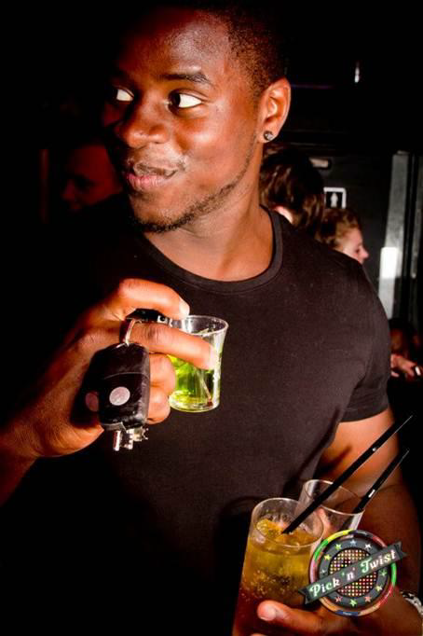
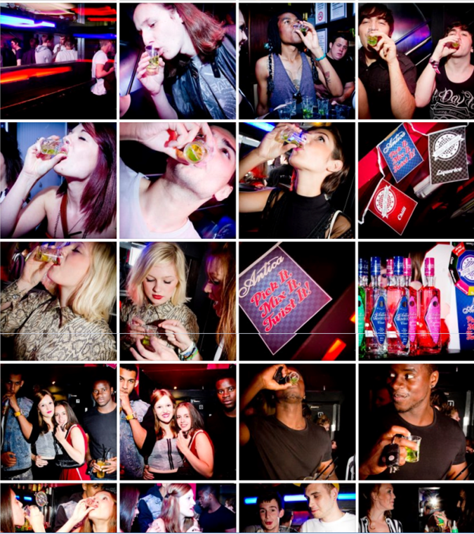
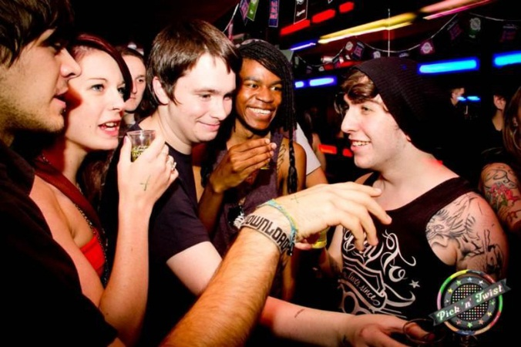
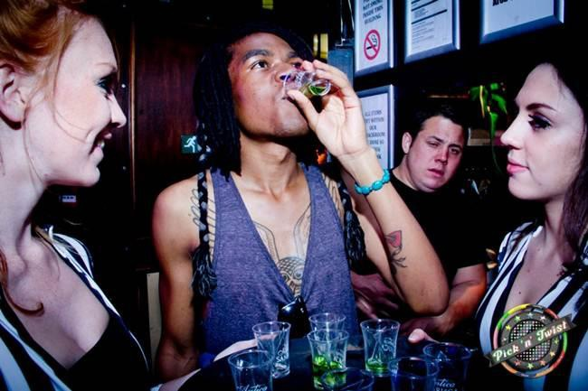
Hi Spirits, 2012
Notes:
The issue
These photos were uploaded by users to Hi Spirit’s Facebook page to promote Antica Sambucca.
We received a complaint that the images promoted excessive drinking, featured people drinking alcohol who appeared to be under 25 years of age, and two of the images linked drinking with driving.
ASA decision: Upheld
We agreed with the complainant as a number of the photos, people were shown to be holding multiple drinks showing that an abundance of alcohol was available and had been consumed. Similarly, some of the pictures suggested that some of the individuals had consumed a large quantity of alcohol and were intoxicated. On this point the images breached the rules under social responsibility and alcohol.
Two of the images showed a man holding multiple drinks and car keys, which we considered linked alcohol with driving and concluded the image was irresponsible. N.B. Hi Spirits did actually remove this image prior to our final ruling. Nonetheless we found it had broken the rules for responsible advertising.
Several of the images had been taken at university Fresher’s week events and so the likelihood is that a number of the attendees would have been new university students and therefore around 18 years of age, which is in breach of the advertising rules for alcohol. We upheld the complaint on this point.

Slide 13
Criminal Damage (2012)
Notes:
The issue
A magazine ad in Drapers Fashion Business Magazine, for a clothing company, featured a black and white image of three young boys dressed in the style of the early twentieth century and smoking cigarettes and a pipe. Text stated "CRIMINAL DAMAGE® TWISTED HERITAGE".
A member of the public complained that the ad was irresponsible.
ASA decision: Upheld
The ASA Council considered that because the ad featured children smoking, a behaviour which was likely to result in their physical harm, the ad condoned an unsafe practice and was therefore irresponsible. The complaint was upheld.

Slide 14
Miu Miu (Prada) (2011)
Notes:
The issue
An ad in Tatler Magazine for Miu Miu, featured the young model/actress Hailee Steinfeld sitting on railway tracks and looking as if she was upset and may have been crying.
A complainant objected that it was irresponsible because it was suggestive of youth suicide, especially because the ad could be seen by impressionable young people. The ASA challenged whether the ad was irresponsible because it showed a child in an unsafe location.
ASA decision: Upheld
Because the ad was placed in a magazine with a mainly adult readership and it showed a stylised image of Hailee Steinfeld dressed in sophisticated 1940s style clothing we considered that readers of the magazine would understand that the image represented a staged fashion shoot. In that context, we thought that the ad was prepared with a due sense of responsibility and would not be suggestive of youth suicide to impressionable young people.
Nevertheless, because the ad showed Hailee Steinfeld, who was 14 years of age when the photo was shot, in a potentially hazardous situation sitting on a railway track, we concluded the ad was irresponsible and in breach of the Code in showing a child in a hazardous or dangerous situation.

Slide 15
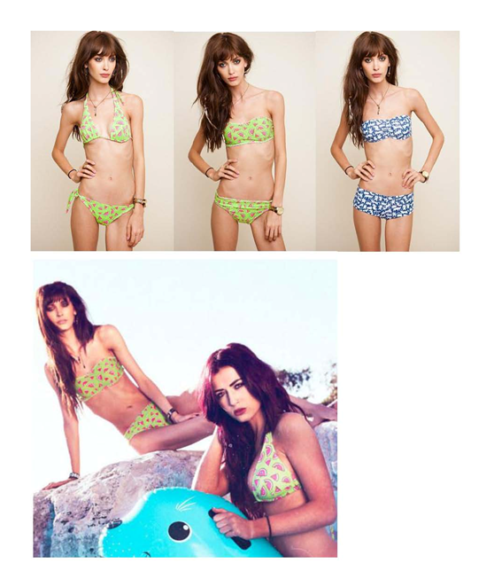
Drop Dead Clothing (2011)
Notes:
The issue
A website ad for an online clothing retailer, Drop Dead Clothing, featured a model in a number of images, including in bikinis and denim shorts.
A complainant objected that the ad was irresponsible and offensive, because they believed the model was underweight and looked anorexic.
ASA decision: Upheld
We noted that Drop Dead Clothing’s target market was young people. We considered that using a noticeably skinny model with visible hip, rib, collar and thigh bones, who wore heavy makeup and was posed in ways that made her body appear thinner, was likely to impress upon that audience that the images were representative of the people who might wear Drop Dead's clothing, and as being something to aspire to. Therefore, while we considered the bikini and denim short images might not cause widespread or serious offence, we concluded they were socially irresponsible.

Slide 16
no added sugar Ltd (2010)
Notes:
The issue
This ad appeared in a children’s clothing catalogue, where the child models were shown holding plastic bags near their faces. Complainants objected that the catalogue was irresponsible because it could be copied by children, leading to their physical harm.
ASA decision: Upheld
Although the catalogue was sent to parents, we felt there was a risk of it being left where children could see it and they could possibly try to emulate it. The complaints were therefore upheld.

Slide 17
Righteous Kill (2008)
Notes:
The issue
We received three complaints from members of the public. Two were that the ad glamorised violence and gun crime, and the final objected to the poster being present at Stockwell station during the Jean Charles De Menezes trial.
ASA decision: Upheld in part
The ASA partially upheld the complaints about this film poster. We acknowledged public concern about gun crime but noted the ads did not show any acts of violence. We considered that most people were likely to understand that the poster reflected the content of the film and the quote, in keeping with the style of the film, was intended to be wryly humorous. We considered that the poster and press ad were unlikely to be seen as irresponsible or to glamorise or glorify gun crime.

Slide 18
Offensive ads
• Advertisements should contain nothing that is likely to cause serious or widespread offence. Particular care should be taken to avoid causing offence on the grounds of race, religion, sex, sexual orientation or disability.
• Compliance with the Code is judged on the context, medium, audience, product and prevailing standards of decency.
• Ads featuring sexual imagery, particularly posters that children are more likely to see, must be carefully targeted and avoid causing harm or offence.
• The fact that a product is offensive to some people is not grounds to remove an ad.

Slide 19
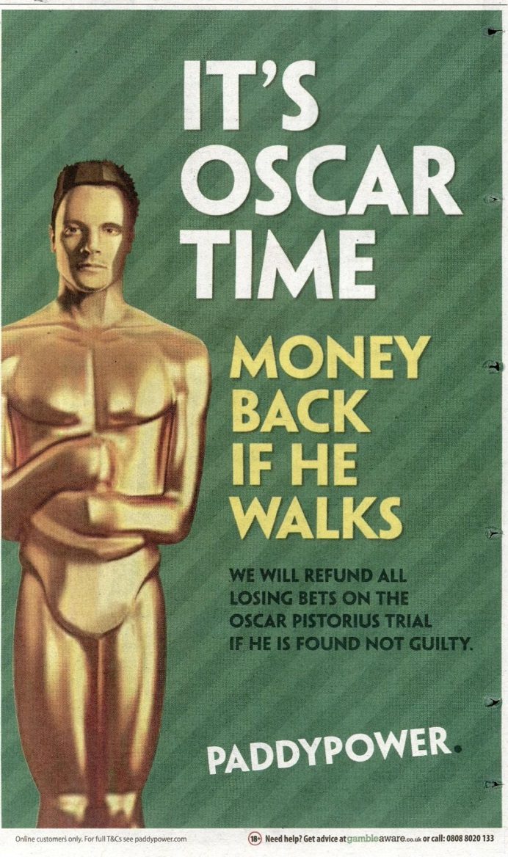
Paddy Power (2014)
Notes:
The issue
At the time this ad appeared in the Sun on Sunday newspaper, the trial of South African Olympic and Paralympic athlete Oscar Pistorius, for the alleged premeditated murder of his girlfriend Reeva Steenkamp, was due to begin in South Africa. We received 5,525 complaints from the public who variously believed the ad was insensitive by trivialising the issues surrounding a murder trial, the death of a woman and also disability, challenged whether the ad was likely to cause serious or widespread offence. We challenged whether the ad brought advertising into disrepute.
Paddy Power said the ad was a one-off and they therefore had no plans to repeat it. They said they had always focused on providing betting as entertainment. Although their marketing, which was known for being mischievous and irreverent, might push the boundaries on occasion, they did not intend to offend.
ASA decision: Upheld
We acknowledged that, while the bet offered was likely to be seen as distasteful by some readers, the ad was for a product we understood was offered legitimately. We also acknowledged that the ad made no explicit reference to death or violence. However, we considered that by making reference to a high profile murder trial, the ad would be interpreted by readers as being inextricably related to the sensitive issues surrounding the trial, and to be making an implied reference to the person who had died. Given the content of the ad, and the prevailing circumstances at the time of its publication, we also concluded that it brought advertising into disrepute.

Slide 20
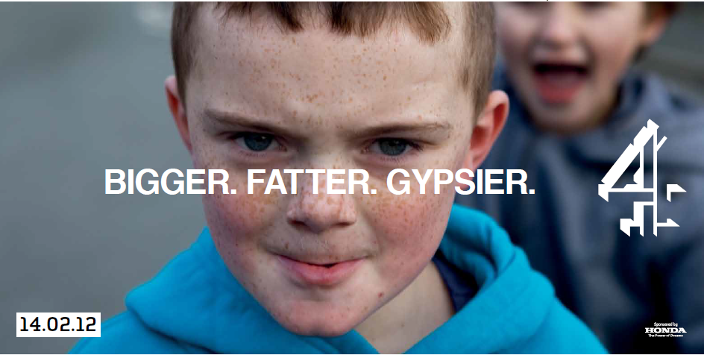
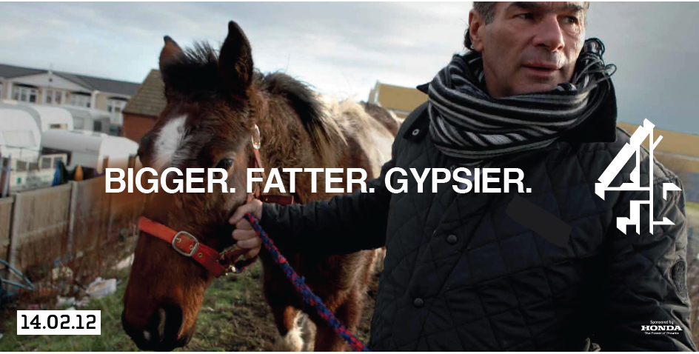
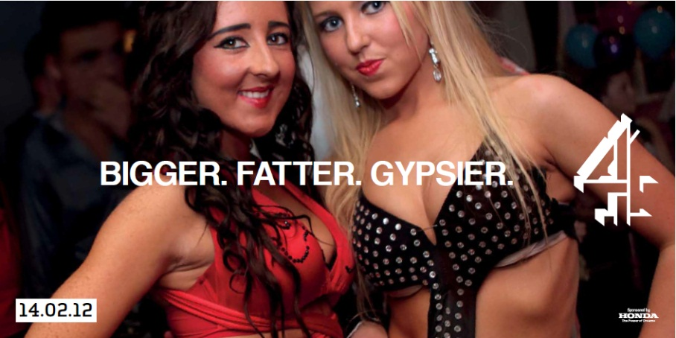
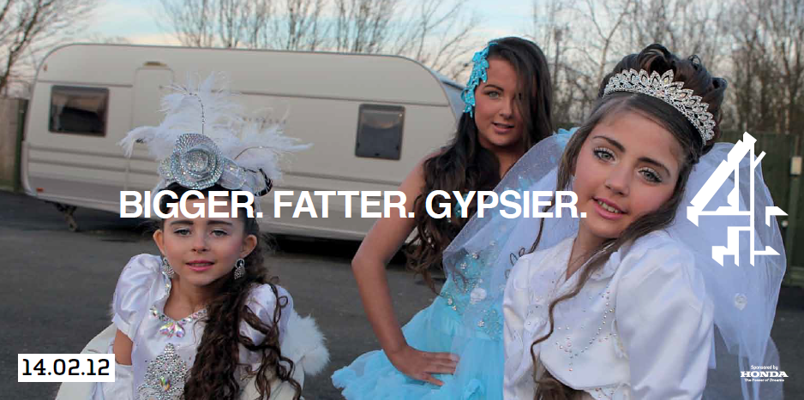
Channel Four Television Corporation, 2012
Notes:
The issue
A series of ads for the TV programme My Big Fat Gypsy Wedding, appearing on posters and in national and regional press and magazines, prompted 372 complaints that they were offensive, racist and unfairly denigrated and degraded Gypsy and Traveller communities.
ASA decision: Upheld in part
The ASA Executive assessed the ads and recommended to the Council that the complaints did not warrant investigation. The Council agreed that recommendation. However, the Irish Traveller Movement in Britain and eight co-complainants sought Independent Review of Council's decision and, as a result, the case was re-opened and investigated. After which, we agreed with complainants that some of the images together with the accompanying text were offensive and irresponsible.

Slide 21
Marc Jacobs ‘Oh Lola’ perfume (2012)
Notes:
The issue
This magazine ad for "Oh, Lola!" perfume attracted complaints from four readers who challenged whether the ad was offensive and irresponsible as it portrayed the young model in a sexualised manner.
The advertisers, Coty Ltd, responded that they did not believe the styling in the ad suggested the model was underage or that the ad was inappropriately sexualised because it did not show any private body parts or sexual activity. They believed the giant perfume bottle was provoking but not indecent.
ASA decision: Upheld
The ASA understood that the ad had appeared in publications with a target readership of those over 25 years of age and that the model was 17 years old but considered she looked under the age of 16. Also the length of her dress, the visibility of her thigh and position of the perfume bottle drew attention to her sexuality. Because of that, along with her appearance, we considered the ad could be seen to sexualise a child. We therefore concluded that the ad was irresponsible and was likely to cause serious offence.

Slide 22
Mr Unique (2012)
Notes:
The issue
This regional press ad, for Mr Unique tyre and exhaust centres, was seen in the Harlow Star and the Hoddesden and Broxbourne Mercury. Two members of the public complained that the ad was likely to cause serious or widespread offence, because they believed it was sexist and also challenged whether the ad was suitable to be distributed in an untargeted medium.
Mr Unique said the ad was in a retro style which they had been using in their advertising for many years. They said that the image was related to their business and that the woman holding the wrench was shown working on a vehicle in a workshop.
ASA decision: Not upheld
We considered that the overall effect of the image, including the woman's facial expression, was only mildly sexual. We also noted that the ad did not contain any innuendo and concluded that, because it was no more than mildly sexual, the ad was suitably targeted. Therefore, the complaints were not upheld.

Slide 23
Phones 4 U Ltd (2011)
Notes:
The issue
Two versions of a national press ad for Phones 4 U Ltd featured a cartoon-like graphical illustration of Jesus Christ grinning broadly and winking, pointing a finger with one hand and displaying a thumbs-up sign with the other. The Sacred Heart was featured on his chest. Headline text stated "Miraculous deals on Samsung Galaxy AndroidTM phones“.
98 complainants challenged whether the ads were offensive, because of the depiction of Jesus Christ and the Sacred Heart, the use of the term "miraculous" in that context and their publication during the Easter period were disrespectful to the Christian faith.
Phones 4 U said the ads were not intended to be disrespectful of the Christian faith nor were they intended to cause offence to Christians. They said they withdrew the ads as soon as the negative reaction became apparent and confirmed they had no plans to run the ads again in their current form or in any similar form.
ASA decision: Upheld
The ASA noted that Phones 4 U had not intended to cause any offence and welcomed their explanation that the ads had been withdrawn following the receipt of negative feedback. Furthermore, the ASA agreed with the complainants that the ads were disrespectful to the Christian faith and were likely to cause serious offence, particularly to Christians. The ads were banned and must not appear again in their current form.

Slide 24
Lynx (2011)
Notes:
The issue
Attracting 114 complaints, this poster featured a woman under an outdoor shower wearing bikini bottoms and clasping an undone bikini top against her breasts. The complaints were that the ad was offensive because it was sexually suggestive, provocative, indecent, glamorised casual sex, and because it objectified and was demeaning to women; irresponsible because it was inappropriate for public display, where it could be seen by children.
ASA decision: Upheld
We considered that, alongside the strap line ‘the cleaner you are the dirtier you get’, the call to action at the bottom of the poster ‘visit facebook.com/lynxeffect and get dirty this summer’, was clearly intended to imply that using the advertised product would lead to more uninhibited sexual behaviour. We therefore considered that the poster would be seen to make a link between purchasing the product and sex with women and in so doing would be seen to objectify women.
We also considered that the combination of the image and the suggestive text, in a poster on public display, was likely to be considered offensive by many members of the public, particularly those who were accompanied by children. We concluded that the poster was likely to cause serious or widespread offence.

Slide 25
Antonio Federici (2010)
Notes:
The issue
This magazine ad, for Antonio Federici ice cream, showed two priests in full robes who looked as though they were about to kiss. One of the men also wore rosary beads and held a spoon in his hand; the other held a tub of ice cream. The ad included text that stated “We Believe in Salivation”. Six complainants objected that the ad was offensive, because they believed it mocked Catholicism.
ASA decision: Upheld
The ASA considered the portrayal of the two priests in a sexualised manner was likely to be interpreted as mocking the beliefs of Roman Catholics and was therefore likely to cause serious offence to some readers. We concluded that the ad breached the Code, and upheld the complaints.

Slide 26
Historical ads
Ads pre-1962
The following ads give some examples of the types of claims advertisers could make in non-broadcast advertisements before the ASA was established, which would certainly not be acceptable today.
For more examples of historical ads, it is worth visiting the History of Advertising Trust which has the largest archive of British ads and marketing communications in the world.

Slide 27
Carbolic Smoke Ball Company, 1890s
Notes:
The Carbolic Smoke Ball Company produced this ad that claimed “£100 reward will be paid…to any person who contracts…influenza, colds or any disease…after having used the ball three times daily for two weeks…”. A Mrs Carhill caught influenza after using the ball and claimed the £100.
The company then claimed the ad was not a serious offer and refused to offer the reward. But Mrs Carhill took the company to court, which sided with her and said the advertisers were bound by the offer.
This case set the precedent for much of the consumer protection law in relation to advertising that exists today.

Slide 28
Coca-Cola 1890s
Notes:
This very early ad for Coca Cola claims to treat headaches and relieves mental and physical exhaustion. This example is from the States as Coca-Cola was not marketed in Britain until the 1920s.

Slide 29
Vigor’s Horse-Action Saddle, 1897
Notes:
This advertisement for the Vigor’s Horse-Action Saddle claimed that by using the device for exercise it could cure a number of illnesses.

Slide 30
Pears Soap 19th Century
“Bringing
civilization to the
dark corners of
the earth”
Notes:
Pears ran a series of ads in the 19th century extolling the virtues of their soap in a colonial context, in which white was civilised and pure and black was in need of civilising. In this ad, the concept is taken literally where the black child is made white after using Pears soap.

Slide 31
The Soda Pop Board of America, 1950s
Notes:
Do yourself a favour start them on a strict regimen of sodas and other sugary carbonated beverages right now for a lifetime of guaranteed happiness. According to this ad, babies who start drinking soda during…formative period have a much higher chance of gaining acceptance.

Slide 32
Thank you
Advertising Standards Authority
Mid City Place, 71 High Holborn
London WC1V 6QT
Telephone 020 7492 2222
schools@asa.org.uk
www.asa.org.uk

